Slide 1
Algorithms Club
Week 2

Slide 2
BIG - O
It’s a big deal
Slides by Mo

Slide 3
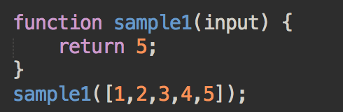
Discussion
Let’s discuss what the following snippet does, and its efficiency.
>> What happens if your input size increases from ‘5’ to ‘1000000000’?

Slide 4
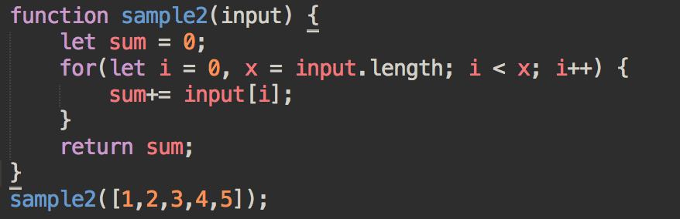
Discussion
Let’s discuss what the following snippet does, and its efficiency.
>> What happens if your input size increases from ‘5’ to ‘1000000000’?

Slide 5
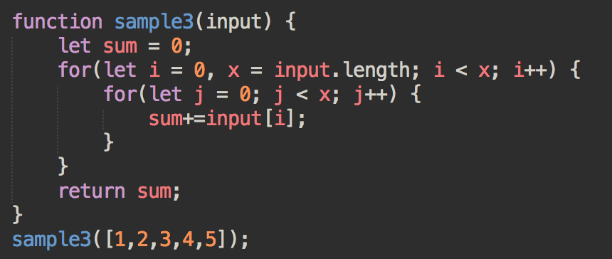
Discussion
Let’s discuss what the following snippet does, and its efficiency.
>> What happens if your input size increases from ‘5’ to ‘1000000000’?

Slide 6
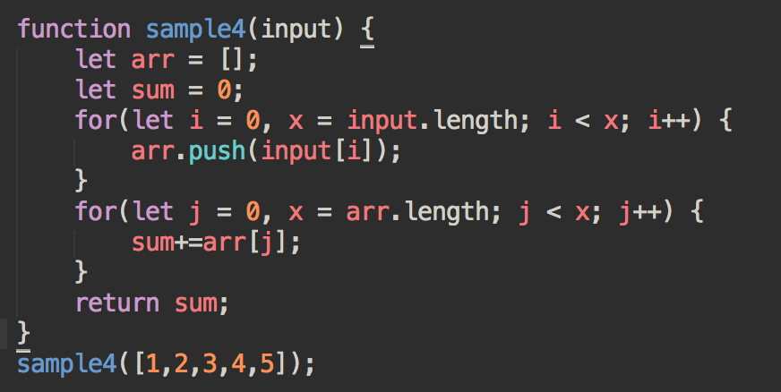
Discussion
Let’s discuss what the following snippet does, and its efficiency.
>> What happens if your input size increases from ‘5’ to ‘1000000000’?

Slide 7
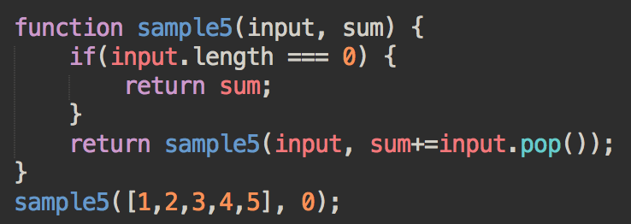
Discussion
Let’s discuss what the following snippet does, and its efficiency.
>> What happens if your input size increases from ‘5’ to ‘1000000000’?

Slide 8
Big O Notation
Big O notation is used to describe WORST-CASE RUNTIME and evaluates how your function performance changes with varying input size.

Slide 9
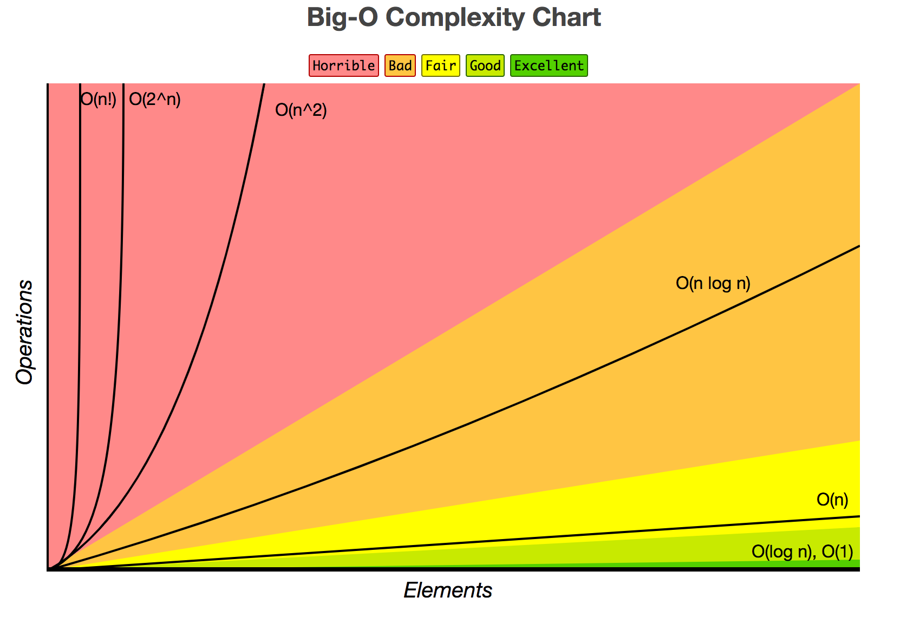
http://bigocheatsheet.com/

Slide 10
Review Questions
What is the worst case runtime complexity (Big-O) for inserting an item at the beginning of an array?
=> O(n)
What is the worst case runtime complexity (Big-O) for deleting an item at the beginning of an array?
=> O(n)
What is the worst case runtime complexity (Big-O) seeing if an item is in an array?
=> O(n)

Slide 11
Review Questions
What is the worst case runtime complexity for accessing an item in an array given the index?
=> O(1)
Is an O(1) function faster than an O(n) function?

Slide 12
Let’s search for stuff
Given a SORTED array of numbers, find a target number (if it exists).
Input: ( [0, 1, 2, 3, 4, …, 99, 100], 2)
Output: 2
Input: ( [0, 1, 2, 3, 4, …, 99, 100], 88)
Output: 88
Input: ( [0, 1, 2, 3, 4, …, 99, 100], 200)
Output: -1

Slide 13
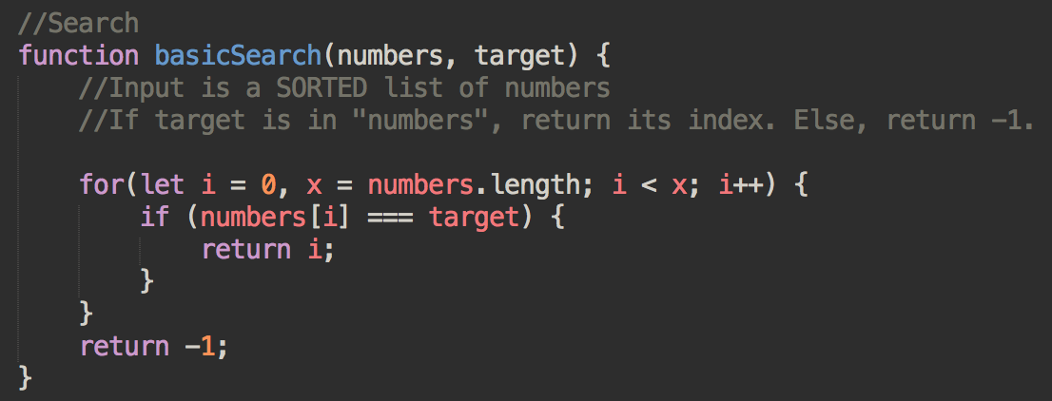
Let’s search for stuff
Runtime: O(?)
Space: O(?)

Slide 14
Let’s search for stuff
Runtime: O(n)
Space: O(1)

Slide 15
How can we improve this?

Slide 16
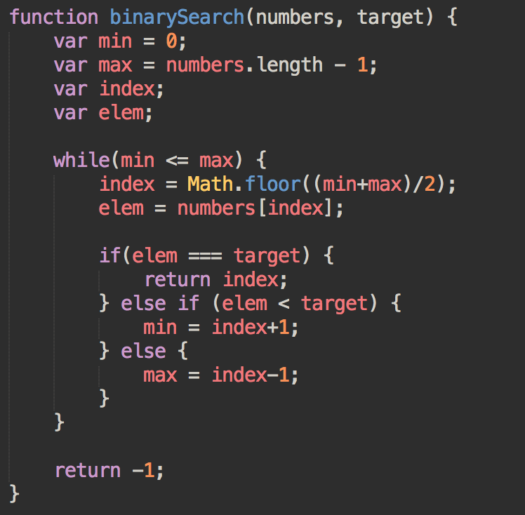
Let’s search for stuff (better)
Runtime: O(?)
Space: O(?)

Slide 17
Uno mas
Given an array of strings, return a duplicate entry if one exists. If there are none, return -1.
Input: ( [“A”, “B”, “C”, “D”, “A”])
Output: A
Input: ([“A”, “B”, “C”, “D”])
Output: -1

Slide 18
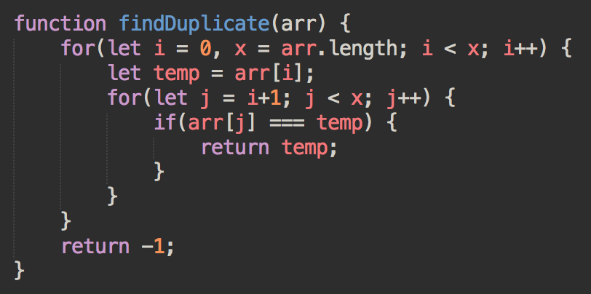
Find Duplicate
Runtime: O(n^2)
Space: O(1)
Why is it n^2? Can we improve this? If so, to what? And how?

Slide 19
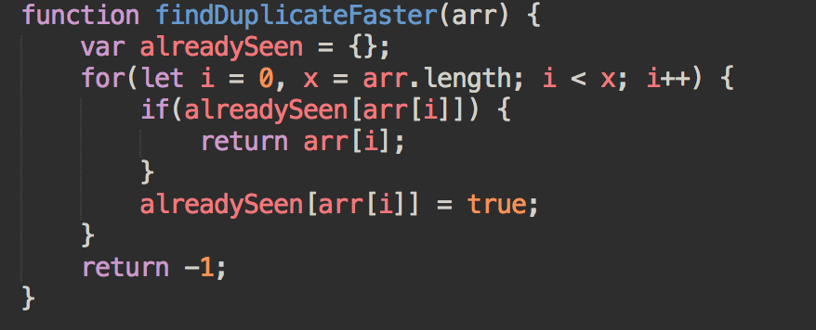
Find Duplicate
Runtime: O(n)
Space: O(n)

Slide 20
http://bigocheatsheet.com/

Slide 21
Sources
http://vlsicad.ucsd.edu/courses/cse21-s14/exercises/bigO-practicesol.pdf
http://web.mit.edu/16.070/www/lecture/big_o.pdf

